Slide 1

Wireless & Mobile Networks concepts and security
Prof. Amine Berqia
Email : berqia@gmail.com

Slide 2
Welcome to WMN
Course logistics
Office hours: by appointment
  I’m very responsive with email
  Grading :
Examination: 50%
Project & Practical exercises: 50%
Bonus : Class participation: 10% E.g. question you ask and how much you interact.

Slide 3
Topics
WLAN: IEEE802.11 …
WPAN: IEEE 802.15 …
Mobile IP
WMAN: IEEE 802.16 …
WWAN: GSM, GPRS, EDGE, 3G…

Slide 4
Mobile Networks
&
Wireless Networks
MN
WN
An user is defined as mobile user if he is capable to
communicate outside of its net of signature conserving
same address.
A system is called wireless if the system proposes a service of
communication completely independent of sockets..

Slide 5
Examples of Mobile and/or
Wireless Networks
 | WN | MN
GSM
UMTS
TCP/IP | x | x
IP Mobile | x
ATM | x | x
DECT |  | x

Slide 6

Cellular Concept

Slide 7
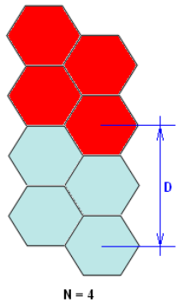
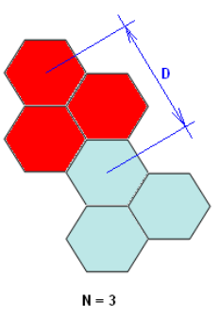
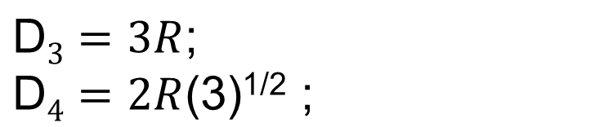

Slide 8
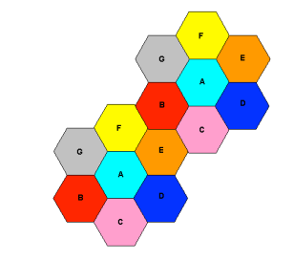


N=7

Slide 9
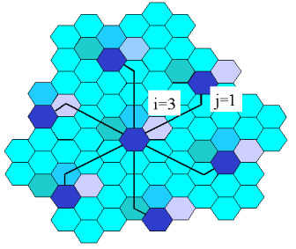
N=13

Slide 10
WLAN
1990 : WLAN project
IEEE (Institute of Electrical and Electronics Engineers) :
  IEEE 802.11
  IEEE 802.15
Hiperlan (High Performance Local Area Network)
  HiperLAN

Slide 11
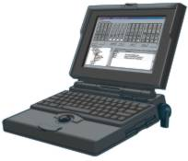





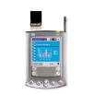
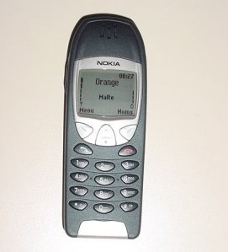
WLAN?
Notebook
iPaq
Server
Notebook
Access Port
Main Corporate Backbone
Switch
Server
Server
PalmPilot
Mobile Phone

Slide 12
IEEE 802.11
MAC Layer
LLC 802.2
802.11f
802.11 – 802.11e – 802.11i
Physical Layer
802.11
DSSS
FHSS
IR
802.11b
802.11g
802.11a

Slide 13
IEEE 802.11
Frequency : band 2,4 GHz;
Infrastructue or Ad-hoc
IEEE 802.11 is Cellular

Slide 14
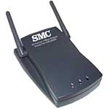
IEEE 802.11 Architecture
ESS
AP
AP
IBSS
BSS
BSS
AP: Access point, BSS : Basic Set service, ESS : Extented Set Service, IBSS Independent BSS.

Slide 15




infrastructure

Slide 16
ad-hoc
IBSS (Independent Basic Service Set)

Slide 17
Method Access
MAC layer:
DCF (Distributed Coordination Function) :
    based on CSMA/CA
PCF (Point Coordination Function) :
    Baseado on polling

Slide 18
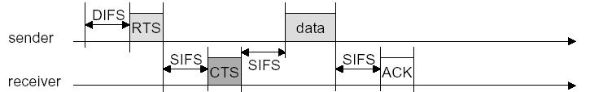
DCF
DIFS (Distributed Inter Frame Space)
SIFS (Short Inter Frame Space)

Slide 19
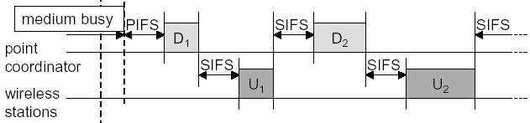
PCF
PIFS (Point Coordenation Inter Frame Space)

Slide 20

Hidden Node Problem
1
2

Slide 21
Hidden Node Problem
1
2
3

Slide 22
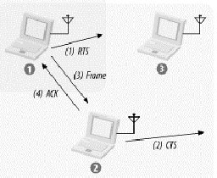
RTS/CTS

Slide 23


Slide 24
Bluetooth
King Viking, Harald Blåtand (english Blåtand = Bluetooth).

Slide 25
History
1994 –Ericsson
1998 –Bluetooth SIG (Special Interest Group):
  Ericsson
  IBM
  Intel
  Nokia
  Toshiba

Slide 26
History
1999 –B-SIG : Microsoft, Lucent Motorola e&3Com
1999 – Version1.0
2001 – First devices
More than 2500 companies in B-SIG

Slide 27
Characteristics
WPAN Technology
ad-hoc
10m till 100m
Low cost
2,4 GHz
Max – 1 Mbps
Modulation GFSK (Gaussian Frequency Shift Keying)

Slide 28
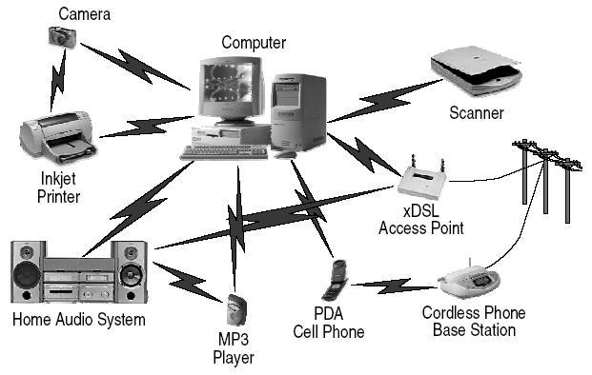
Bluetooth (1)

Slide 29
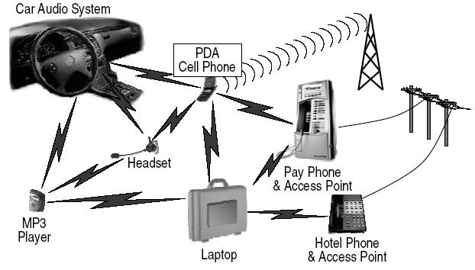
Bluetooth (2)

Slide 30
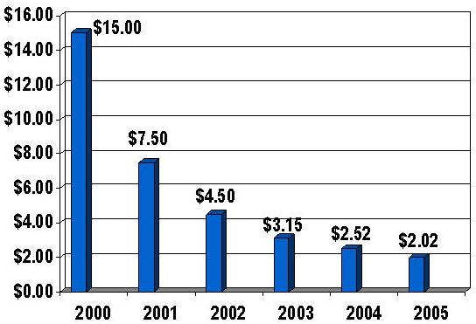
Cost USA

Slide 31
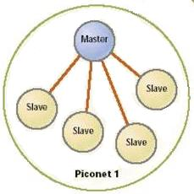

Slide 32
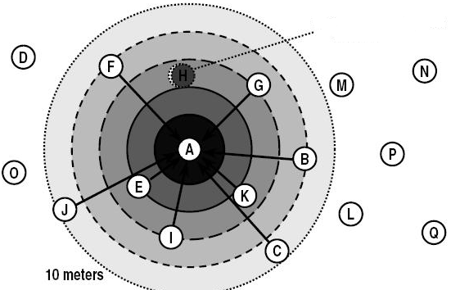
Inquiry

Slide 33
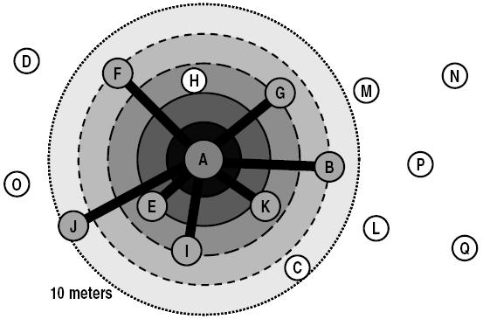
Paging

Slide 34
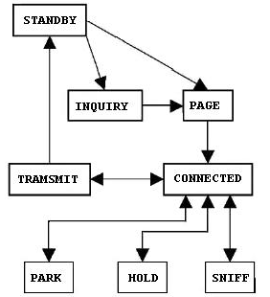
States

Slide 35
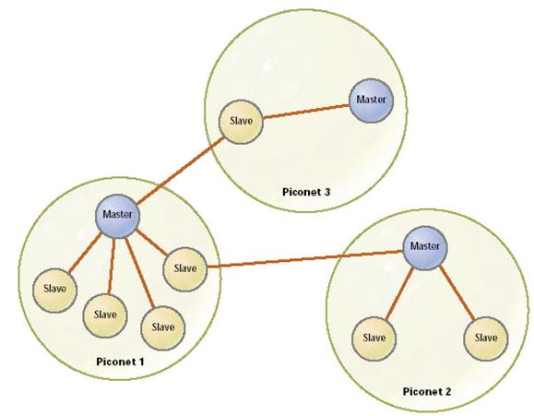
Scatternet

Slide 36
Mobile IP

Slide 37


Slide 38
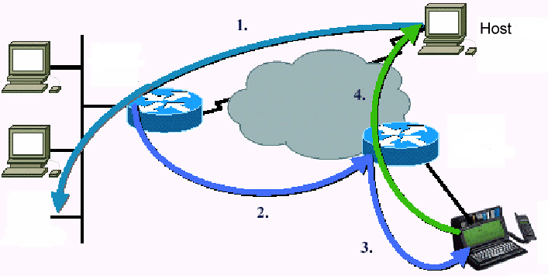

Slide 39
CN
Home network
Foreign network1
HA
FA1
MN
Foreign network2
FA2
MN

Slide 40
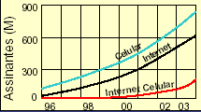
GSM++ Technologies
GSM
HSCSD
GPRS
EDGE
Web site Ericsson

Slide 41
GSM - HSCSD – GPRS - EDGE
GSM - Global System for Mobile communications
HSCSD - High Speed Circuit Switched Data
GPRS - General Packet Radio Service
EDGE = Enhanced Data rates for GSM Evolution

Slide 42
GSM
1979: reservation of the band of the 900 MHz for mobile communications in Europe (IUT);
1980: creation of GSM (Groupe Spécial Mobile) working group
1992: real commercialization of first systems GSM
Since, the GSM communications left its French acronym for the one of Global System for Mobile communications and supplanted the analogical
systems.
frequency:
- band 890-915 Mhz for the uplink (TM for BTS)
- band 935-960 Mhz for the downlink (BTS for TM)

Slide 43
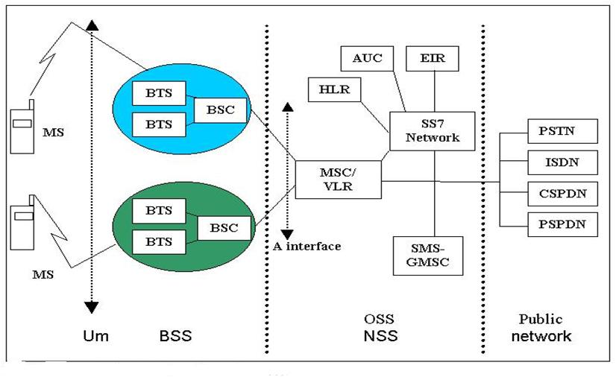
General Architecture

Slide 44
BSS : Base Station Subsystem
MS (Mobile Station) : visible part of the system mobile radio.
BTS (Base Transceiver Station) : points of access net GSM. The BTSs are materialized under the form of antennas on the the buildings in the city or on the edge of the road.
BSC (Base Station Controller) : a BSC generates the canals radios and the BTS applies the decisions taken by the BSC (as the control of admission of the calls and the management of handovers).

Slide 45
NSS : Network SubSystem
MSC (Mobile-services Switching Center) : The MSC is a numerical switch that manages all the communications under its covering area;
HLR (Home Location Register) : database of nominal localization in which the relative information to the subscribers of a mobile net are stored;
VLR (Visitor Location Register) : database of Local localization in which the relative information to the users of a specific region are stored .

Slide 46
GSM Services
Voice
Data
Short Message Services (SMS)
Sec.
QoS!!!

Slide 47
HSCSD & GPRS vs GSM
Multislot
Uni-timeslot
HSCSD e GPRS
GSM

Slide 48



GSM + GPRS
Other nets
BSS : software upgrade
hardware upgrade
New components
(SGSN – GGSN)
PSTN
GGSN
MSC
SGSN
BSC
PCU
GSM
BTS
GSM
BTS

Slide 49
Gateway GPRS Support Node GGSN
Interface for external Nets
Like traditional Gateway
Routing
…
IP
Network
Gi (IP)
GGSN
MS

Slide 50
Serving GPRS Support Node - SGSN
In same level like MSC
Packets transfer between MS & GGSN.
…
IP
Network
Gi (IP)
SGSN
GGSN
Gn
MS

Slide 51
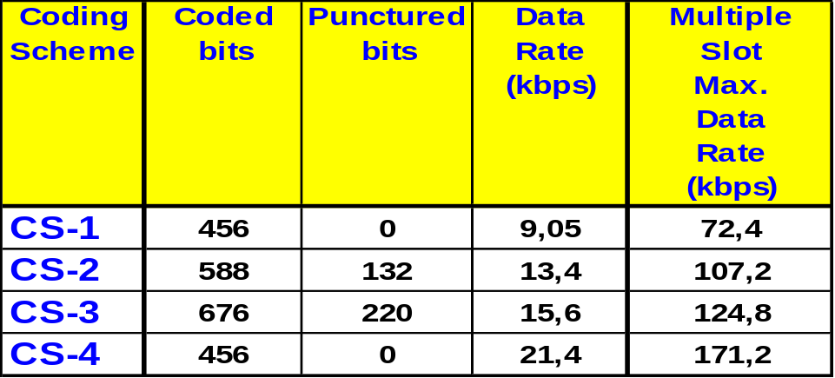
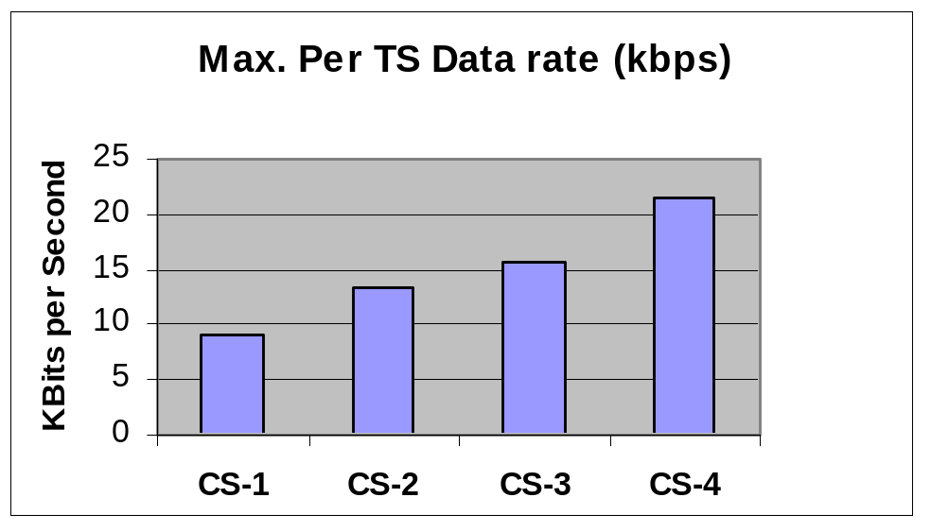
Coding Scheme
Notes:
In this slide, maximum theoretical data rate figures are shown for the four coding schemes. These maximum values for the data rate are obtained assuming a mobile is able to use up to 8 GPRS timeslots.

Slide 52
Timeslot sharing
BCCH
TCH
TCH
TCH
TCH
GPRS
GPRS
GPRS
CS2 = 40.2 kbps
BTS

Slide 53
Timeslot sharing
BCCH
TCH
TCH
TCH
TCH
TCH
GPRS
GPRS
CS2 = 26.8 kbps
BTS

Slide 54



MS States
GPRS Attach
IDLE
unreachable mobile
Explicit Detach
GPRS Detach
Timer expiry/
Force STANDBY/
Abnormal RLC condition
READY
reachable mobile
PDU Transmission /Reception
STANDBY

Slide 55
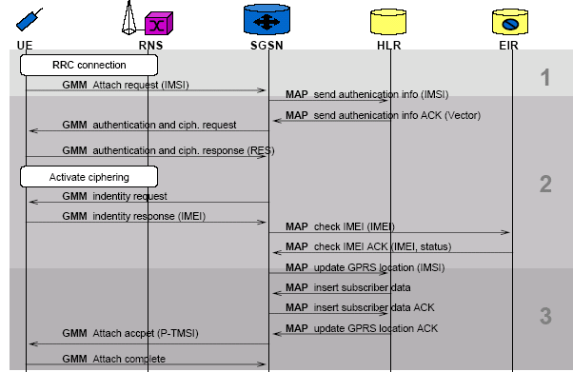
Attach

Slide 56
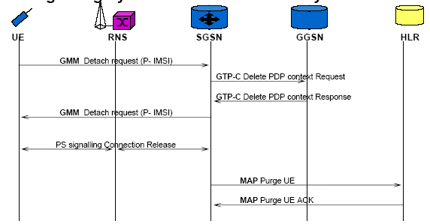
Detach

Slide 57

EDGE
EDGE = Enhanced Data rates for GSM Evolution

Slide 58
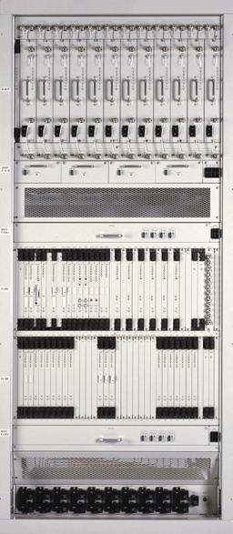

EDGE Classes
BTS
MS
Downlink
Uplink
Classe | Downlink | Uplink
A | 8PSK | GMSK
B | 8PSK | 8PSK

Slide 59
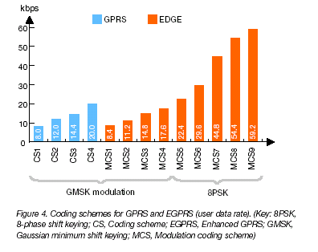
EDGE Coding Schemes

Slide 60
EDGE Impact
Hardware upgrade in BSS
Software upgrade for BS and BSC
New Terminals
- Terminal : 8PSK uplink e downlink
- Terminal : GMSK uplink e 8PSK downlink

Slide 61




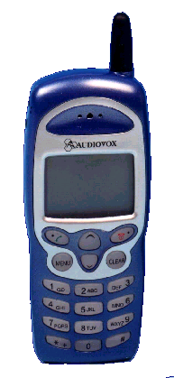
GSM + GPRS + EDGE
Abis
PSTN
BTS
BSC
Abis
NEW
A
MSC
HLR
A
D
NEW
NEW
Gb
NEW
NEW
Gs
BTS
NEW
Gc
SGSN
NEW
NEW
Gn
NEW
GGSN
NEW
Gn
NEW
Gi
PDN
NEW

Slide 62
Wireless Networks Security
Prof. Amine Berqia berqia@gmail.com

Slide 63
IEEE 802.11 Basic Security Mechanisms
Service Set Identifier (SSID)
MAC Address filtering
Wired Equivalent Privacy (WEP) protocol
802.11 products are shipped by the vendors with all security mechanisms disabled !!

Slide 64
Service Set Identifier (SSID) and their limits!
Limits access by identifying the service area covered by the access points.
AP periodically broadcasts SSID in a beacon.
End station listens to these broadcasts and chooses an AP to associate with based upon its SSID.
Use of SSID – weak form of security as beacon management frames on 802.11 WLAN are always sent in the clear.
A hacker can use analysis tools (eg. AirMagnet, Netstumbler, AiroPeek) to identify SSID.
Some vendors use default SSIDs which are pretty well known (eg. CISCO uses tsunami)

Slide 65
MAC Address Filtering
The system administrator can specify a list of MAC addresses that can communicate through an access point.
Advantage :
Provides a little stronger security than SSID
Disadvantages :
Increases Administrative overhead
Reduces Scalability
Determined hackers can still break it

Slide 66
Wired Equivalent Privacy (WEP)
Designed to provide confidentiality to a wireless network similar to that of standard LANs.
WEP is essentially the RC4 symmetric key cryptographic algorithm (same key for encrypting and decrypting).
Transmitting station concatenates 40 bit key with a 24 bit Initialization Vector (IV) to produce pseudorandom key stream.
Plaintext is XORed with the pseudorandom key stream to produce ciphertext.
Ciphertext is concatenated with IV and transmitted over the Wireless Medium.
Receiving station reads the IV, concatenates it with the secret key to produce local copy of the pseudorandom key stream.
Received ciphertext is XORed with the key stream generated to get back the plaintext.

Slide 67
WEP – vulnerability to attack
WEP has been broken! Walker (Oct 2000), Borisov et. al. (Jan 2001), Fluhrer-Mantin -Shamir (Aug 2001).
Unsafe at any key size : Testing reveals WEP encapsulation remains insecure whether its key length is 1 bit or 1000 or any other size.
More about this at: http://grouper.ieee.org/groups/802/11/Documents/DocumentHolder/0-362.zip

Slide 68

WEP Overview
WEP relies on a shared key K between communicating parties
Checksum: For a message M, we calculate c(M). The plaintext is P={M,c(M)}
Encryption: The plaintext is encrypted using RC4. RC4 requires an initialization vector (IV) v, and the key K. Output is a stream of bits called the keystream. Encryption is XOR with P.
Transmission: The IV and the ciphertext C are transmitted.
Message
CRC
RC4(v,K)
v
Ciphertext
Transmit

Slide 69
WEP Security Goals
WEP had three main security goals:
  Confidentiality: Prevent eavesdropping
  Access Control: Prevent inappropriate use of 802.11 network, such as facilitate dropping of not-authorized packets
  Data Integrity: Ensure that messages are not altered or tampered with in transit
The basic WEP standard uses a 40-bit key (with 24bit IV)
Additionally, many implementations allow for 104-bit key (with 24bit IV)
None of the three goals are provided in WEP due to serious security design flaws and the fact that it is easy to eavesdrop on WLAN

Slide 70
128 bit WEP
Vendors have extended WEP to 128 bit keys.
  104 bit secret key.
  24 bit IV.
Brute force takes 10^19 years for 104-bit key.
Effectively safeguards against brute force attacks.

Slide 71
Key Scheduling Weakness
Paper from Fluhrer, Mantin, Shamir, 2001.
Two weaknesses:
  Certain keys leak into key stream.
    Invariance weakness.
  If portion of PRNG input is exposed,
    Analysis of initial key stream allows key to be determined.
    IV weakness.
Notes:
The invariance weakness is the existence of specific patterns, which when these patterns appear in RC4 keys, are likely to appear in the generated key stream and consequently their occurrences (in the secret key) can be easily isolated by simple analysis of the stream (sometimes the ciphertext itself is enough).
The IV weakness is a practical ciphertext only attack on the WEP mode of operation of RC4, when the combination of the key and the IV is made in a simple method such as concatenation.

Slide 72
IV weakness
WEP exposes part of PRNG input.
  IV is transmitted with message.
  Every wireless frame has reliable first byte
    Sub-network Access Protocol header (SNAP) used in logical link control layer, upper sub-layer of data link layer.
    First byte is 0xAA
  Attack is:
    Capture packets with weak IV
    First byte ciphertext XOR 0xAA = First byte key stream
    Can determine key from initial key stream
Practical for 40 bit and 104 bit keys
Passive attack.
  Non-intrusive.
  No warning.

Slide 73
Wepcrack
First tool to demonstrate attack using IV weakness.
  Open source, Anton Rager.
Three components
  Weaker IV generator.
  Search sniffer output for weaker IVs & record 1st byte.
  Cracker to combine weaker IVs and selected 1st bytes.
Cumbersome.
Notes:
Attack relies on tcp/ip packets having well known first bytes.
1 - WeakIVGen.pl - This script allows a simple emulation of IV/encrypted output that one might observe with a WEP enable 802.11 Access Point. The script generates IV combinations that can weaken the secret key used to encrypt the WEP traffic
2 - prism-getIV.pl - This script relies on output from Prismdump [or from Ethereal captures if libpcap has been patched for 802.11 monitor mode], and looks for IVs that match the pattern known to weakned secret keys. This script also captures the 1st byte of the encrypted output and places it and the weak IVs in a logfile.
3 - WEPCrack.pl - This script uses data collected or generated by WeakIVGen to attempt to determine the secret key. It will work with either 40bit or 128bit WEP.

Slide 74
Airsnort
Automated tool
  Cypher42, Minnesota, USA.
  Does it all!
  Sniffs
  Searches for weaker IVs
  Records encrypted data
  Until key is derived.
100 Mb to 1 Gb of transmitted data.
3 to 4 hours on a very busy WLAN.

Slide 75
Avoid the weak IVs
FMS described a simple method to find weak IVs
  Many manufacturers avoid those IVs after 2002
  Therefore Airsnort and others may not work on recent hardware
However David Hulton aka h1kari
  Properly implemented FMS attack which shows many more weak IVs
  Identified IVs that leak into second byte of key stream.
  Second byte of SNAP header is also 0xAA
  So attack still works on recent hardware
  And is faster on older hardware
  Dwepcrack, weplab, aircrack

Slide 76
Generating WEP traffic
Not capturing enough traffic?
  Capture encrypted ARP request packets
  Anecdotally lengths of 68, 118 and 368 bytes appear appropriate
  Replay encrypted ARP packets to generate encrypted ARP replies
  Aireplay implements this.

Slide 77
802.11 safeguards
Security Policy & Architecture Design
Treat as untrusted LAN
Discover unauthorised use
Access point audits
Station protection
Access point location
Antenna design

Slide 78
Security Policy & Architecture
Define use of wireless network
  What is allowed
  What is not allowed
Holistic architecture and implementation
  Consider all threats.
  Design entire architecture
    To minimise risk.

Slide 79
Wireless as untrusted LAN
Treat wireless as untrusted.
  Similar to Internet.
Firewall between WLAN and Backbone.
Extra authentication required.
Intrusion Detection
  at WLAN / Backbone junction.
Vulnerability assessments

Slide 80
Discover unauthorised use
Search for unauthorised access points, ad-hoc networks or clients.
Port scanning
  For unknown SNMP agents.
  For unknown web or telnet interfaces.
Warwalking!
  Sniff 802.11 packets
  Identify IP addresses
  Detect signal strength
  But may sniff your neighbours…
Wireless Intrusion Detection
  AirMagnet, AirDefense, Trapeze, Aruba,…

Slide 81
Access point audits
Review security of access points.
Are passwords and community strings secure?
Use Firewalls & router ACLs
  Limit use of access point administration interfaces.
Standard access point config:
  SSID
  WEP keys
  Community string & password policy

Slide 82
Station protection
Personal firewalls
  Protect the station from attackers.
VPN from station into Intranet
  End-to-end encryption into the trusted network.
  But consider roaming issues.
Host intrusion detection
  Provide early warning of intrusions onto a station.
Configuration scanning
  Check that stations are securely configured.

Slide 83
Location of Access Points
Ideally locate access points
  In centre of buildings.
Try to avoid access points
  By windows
  On external walls
  Line of sight to outside
Use directional antenna to “point” radio signal.

Slide 84
WPA
Wi-Fi Protected Access
  Works with 802.11b, a and g
“Fixes” WEP’s problems
Existing hardware can be used
802.1x user-level authentication
TKIP
  RC4 session-based dynamic encryption keys
  Per-packet key derivation
  Unicast and broadcast key management
  New 48 bit IV with new sequencing method
  Michael 8 byte message integrity code (MIC)
Optional AES support to replace RC4

Slide 85
WPA and 802.1x
802.1x is a general purpose network access control mechanism
WPA has two modes
  Pre-shared mode, uses pre-shared keys
  Enterprise mode, uses Extensible Authentication Protocol (EAP) with a RADIUS server making the authentication decision
  EAP is a transport for authentication, not authentication itself
  EAP allows arbitrary authentication methods
  For example, Windows supports
    EAP-TLS requiring client and server certificates
    PEAP-MS-CHAPv2

Slide 86
Practical WPA attacks
Dictionary attack on pre-shared key mode
  CoWPAtty, Joshua Wright
Denial of service attack
  If WPA equipment sees two packets with invalid MICs in 1 second
    All clients are disassociated
    All activity stopped for one minute
    Two malicious packets a minute enough to stop a wireless network

Slide 87
802.11i
Robust Security Network extends WPA
  Counter Mode with Cipher Block Chaining Message Authentication Code Protocol (CCMP)
  Based on a mode of AES, with 128 bits keys and 48 bit IV.
  Also adds dynamic negotiation of authentication and encryption algorithms
  Allows for future change
Does require new hardware
www.drizzle.com/~aboba/IEEE/

Slide 88
Relevant RFCs
Radius Extensions: RFC 2869
EAP: RFC 2284
EAP-TLS: RFC 2716

